Slide 1
Advanced Android Application Development
3 – Activity Lifecycle and Data, Content Providers and Loaders

Slide 2
Contents
Activity Lifecycle
Active and Visible Lifetimes
Lifecycle Events
Activity Termination
Maintaining State
Storing Data in Android
Storage Options
SQLite
Why Content Providers Matter

Slide 3
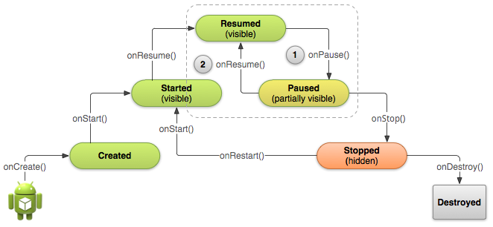
Activity Lifecycle

Slide 4
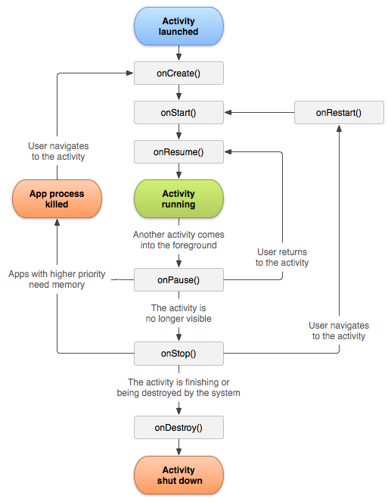

Slide 5
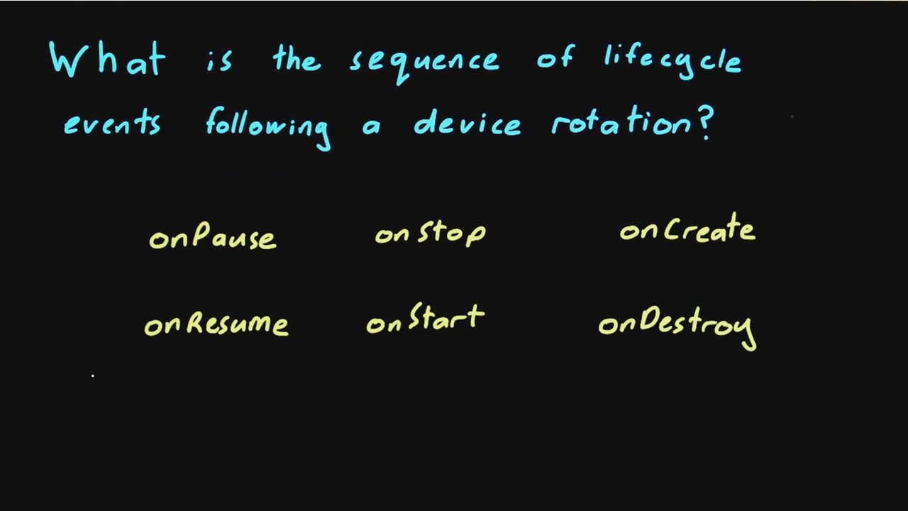
Lifecycle Events

Slide 6
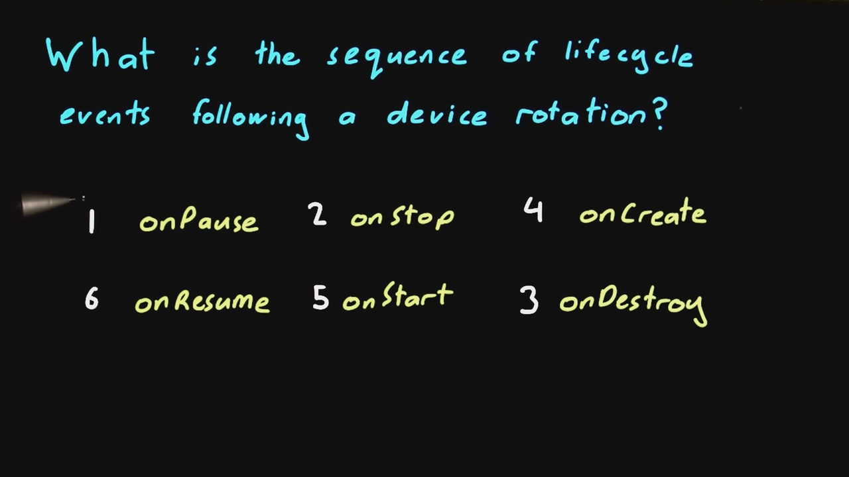
Lifecycle Events Solution

Slide 7
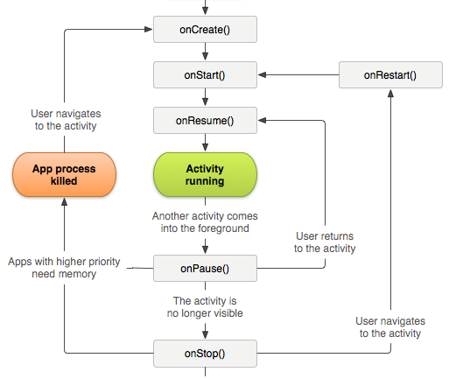
Activity Termination

Slide 8
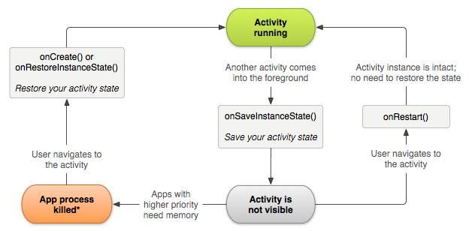
Maintaining State

Slide 9
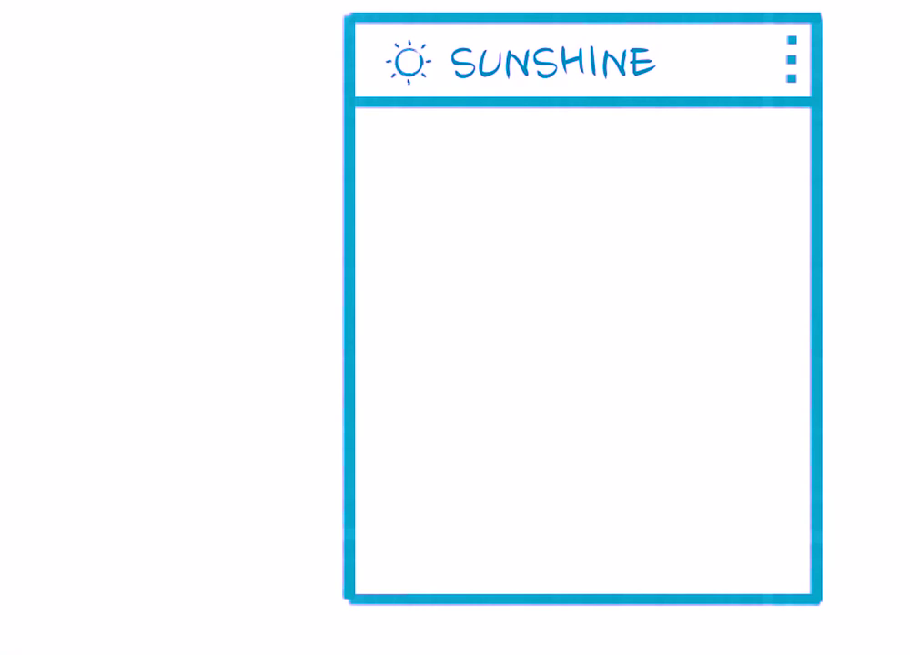
Storing Data in Android User Experience

Slide 10
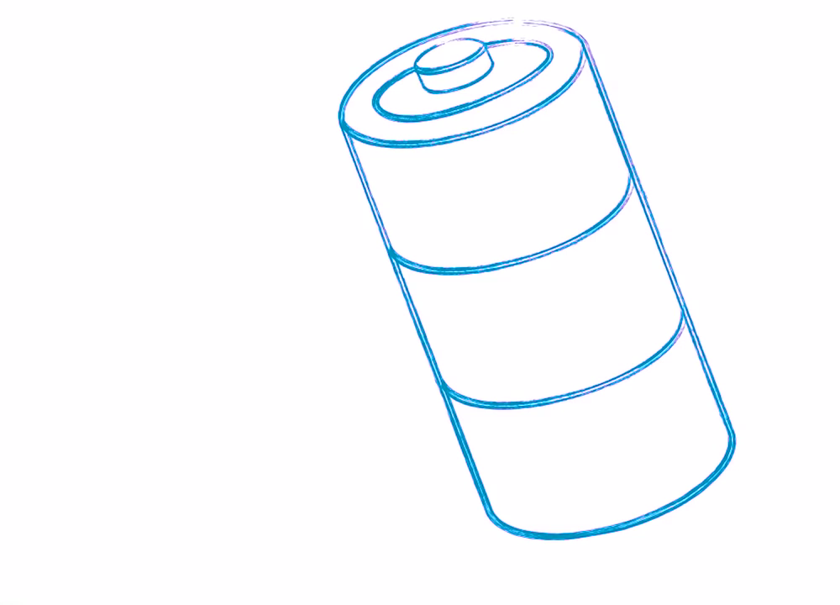
Storing Data in Android Battery Life

Slide 11

Storing Data in Android Data Plans or Roaming

Slide 12
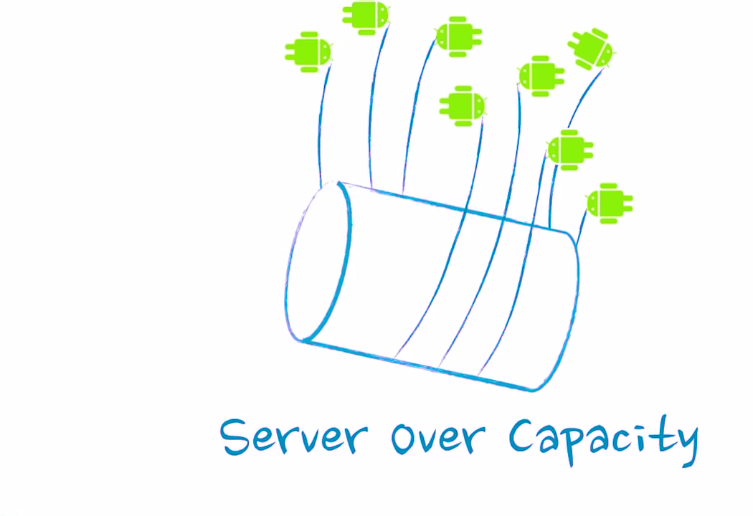
Storing Data in Android Server Load and Network Bandwidth

Slide 13
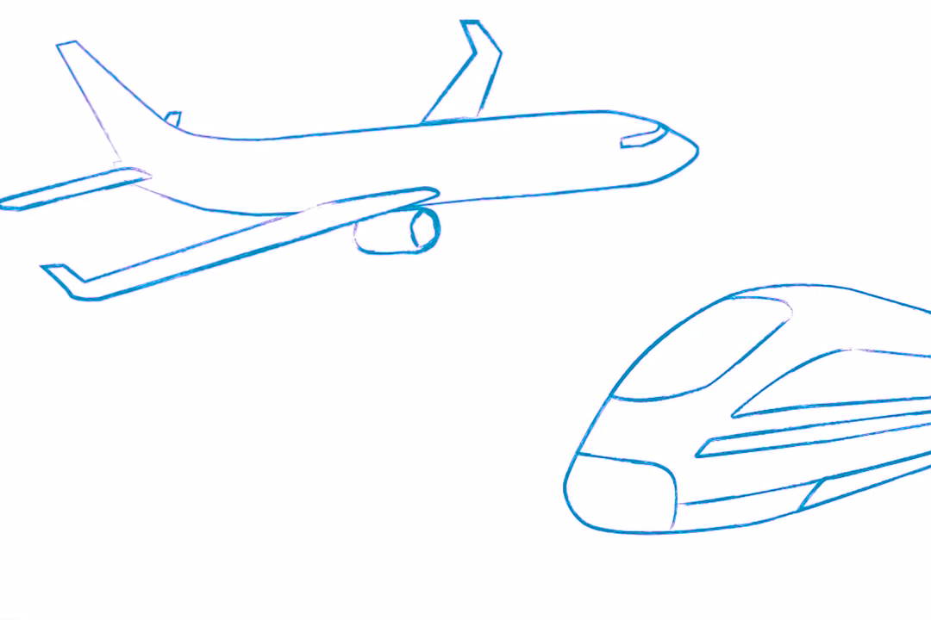
Storing Data in Android Network Connection

Slide 14
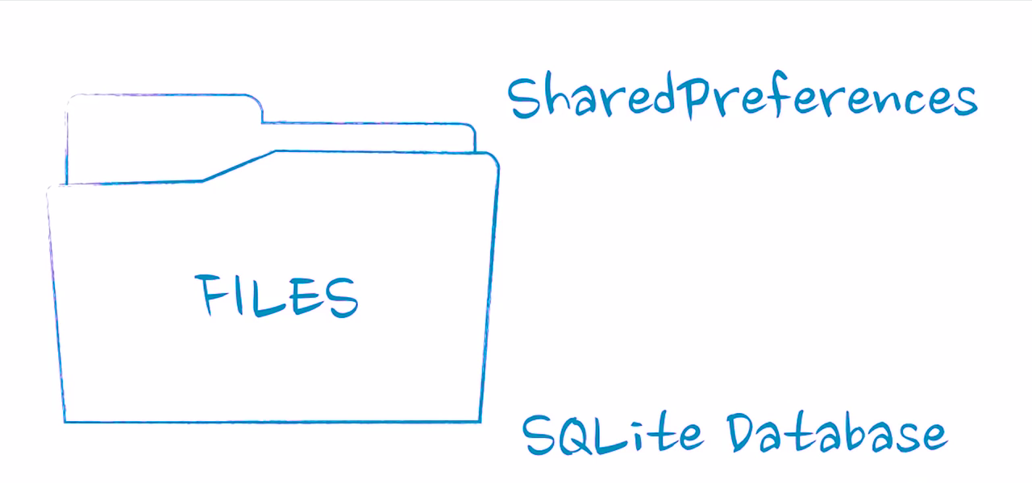
Storage Options

Slide 15
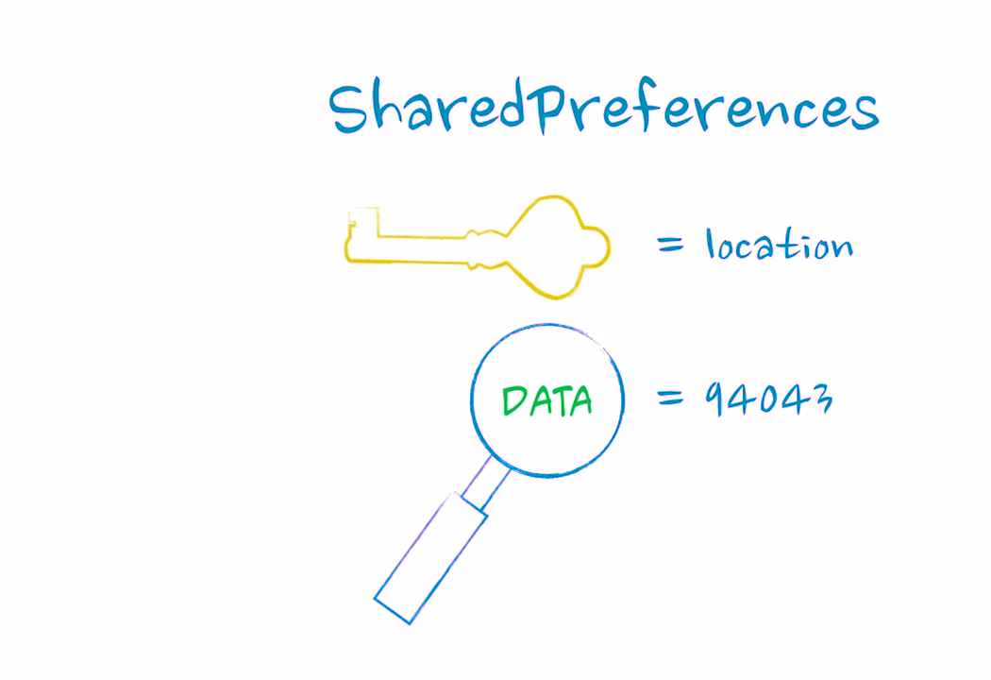
Storage Options SharedPreferences

Slide 16
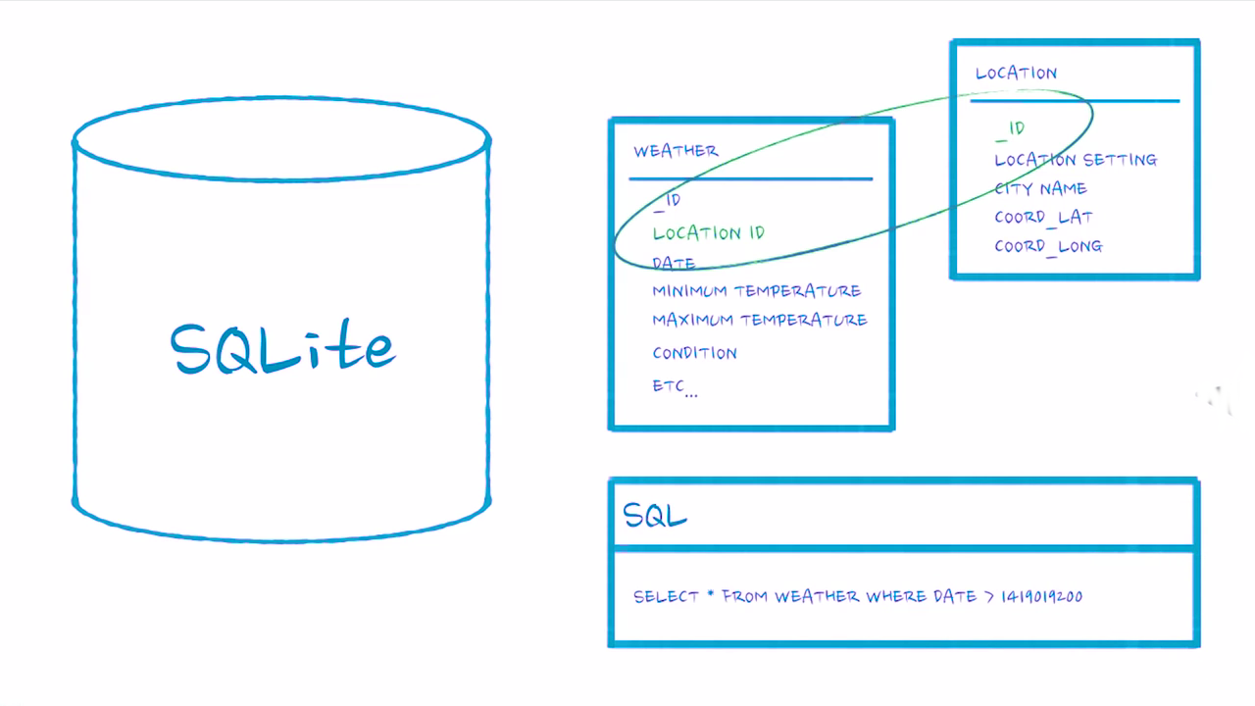
Storage Options SQLite

Slide 17
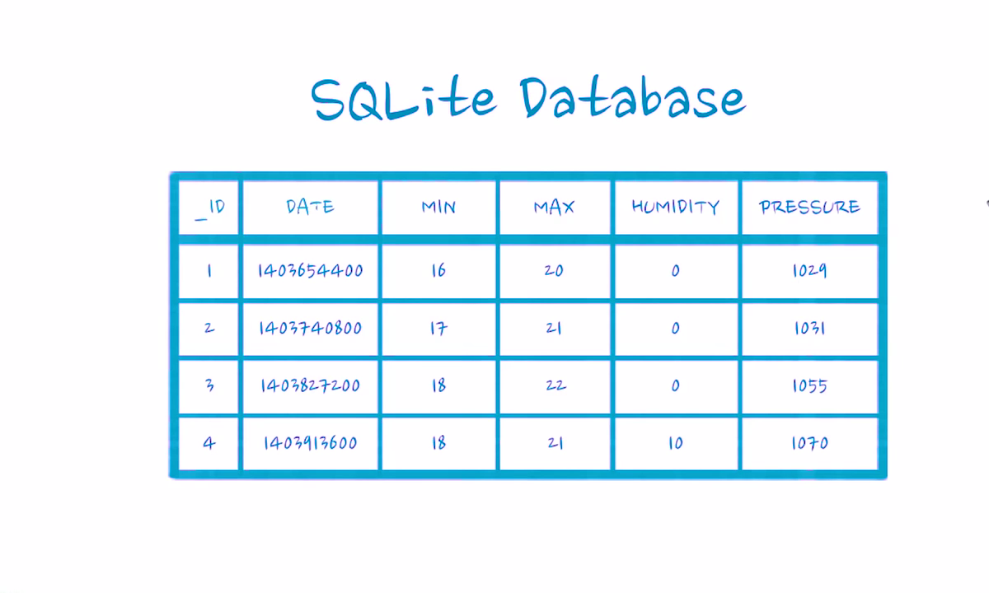

Slide 18
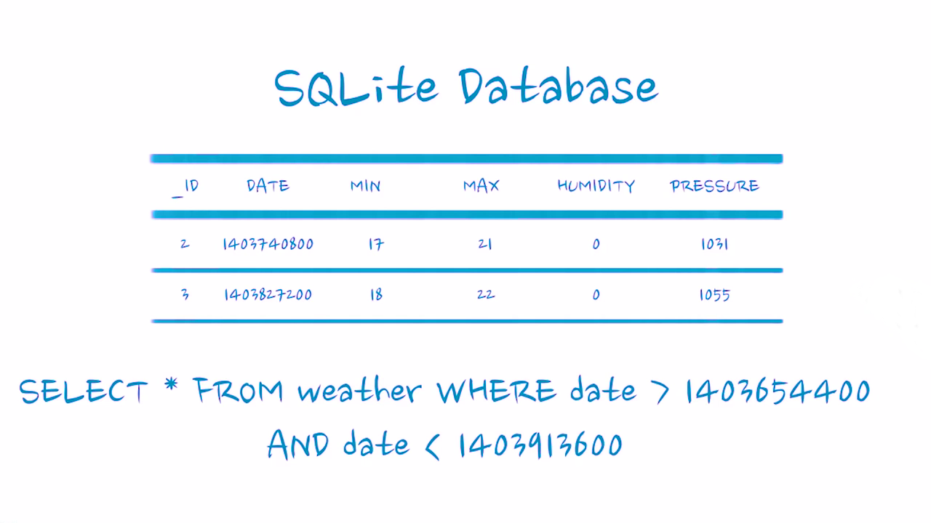

Slide 19
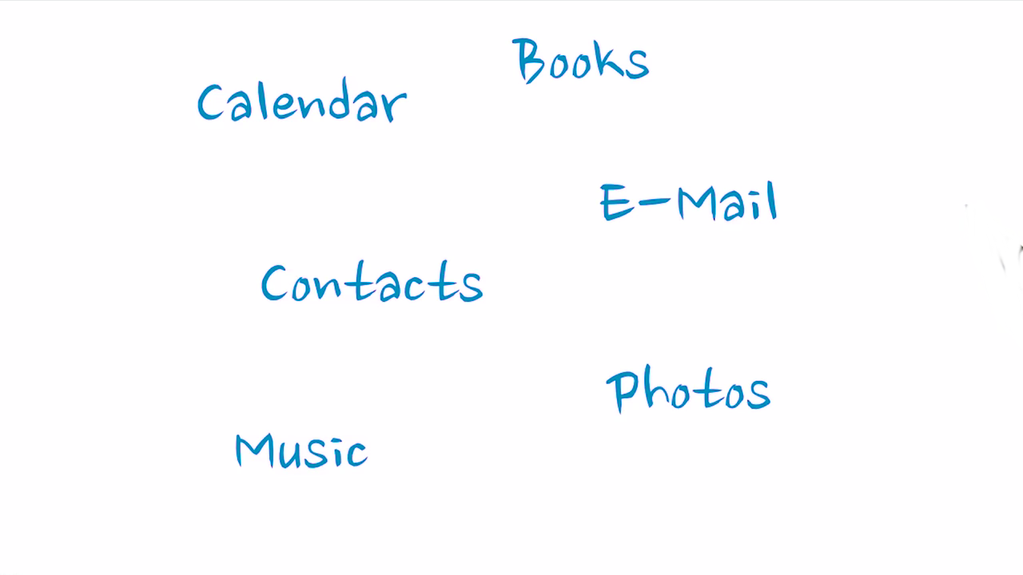
SQLite Usage

Slide 20
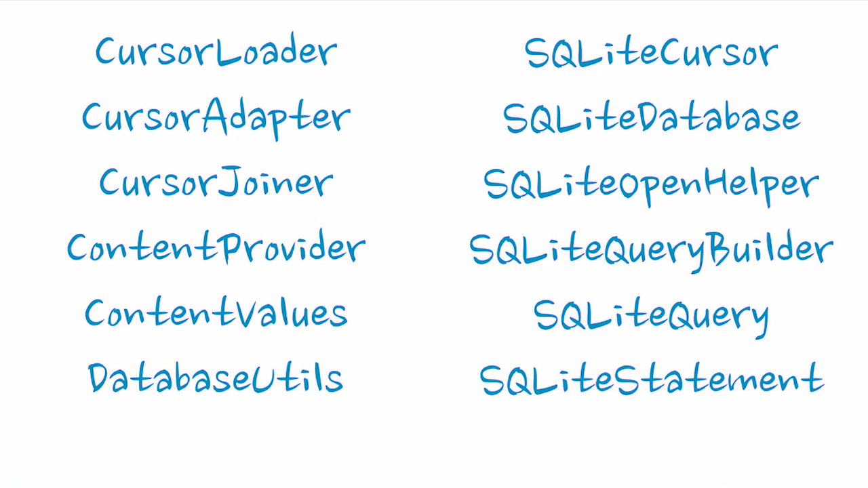
Helper Functions

Slide 21
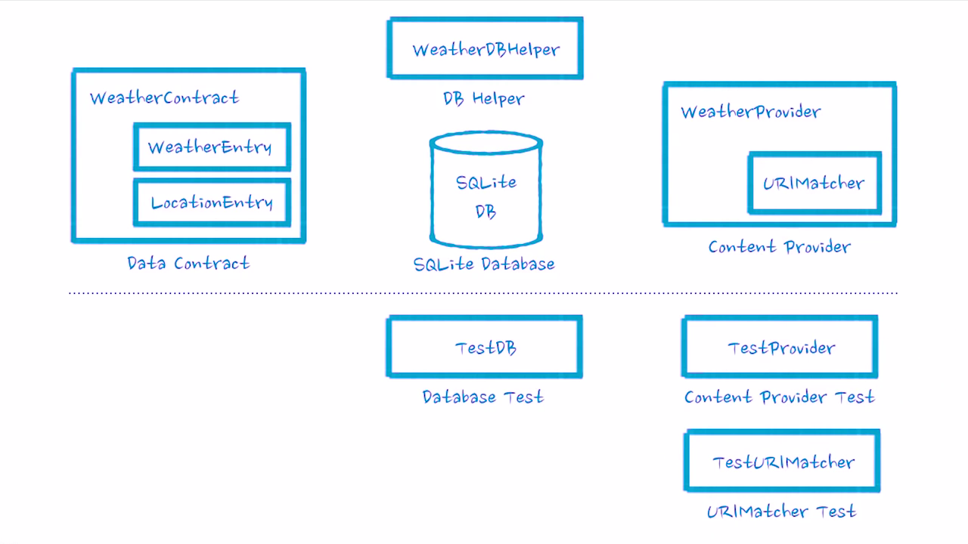
Data Storage Solution Database Contract, Content Provider, DB Helper

Slide 22
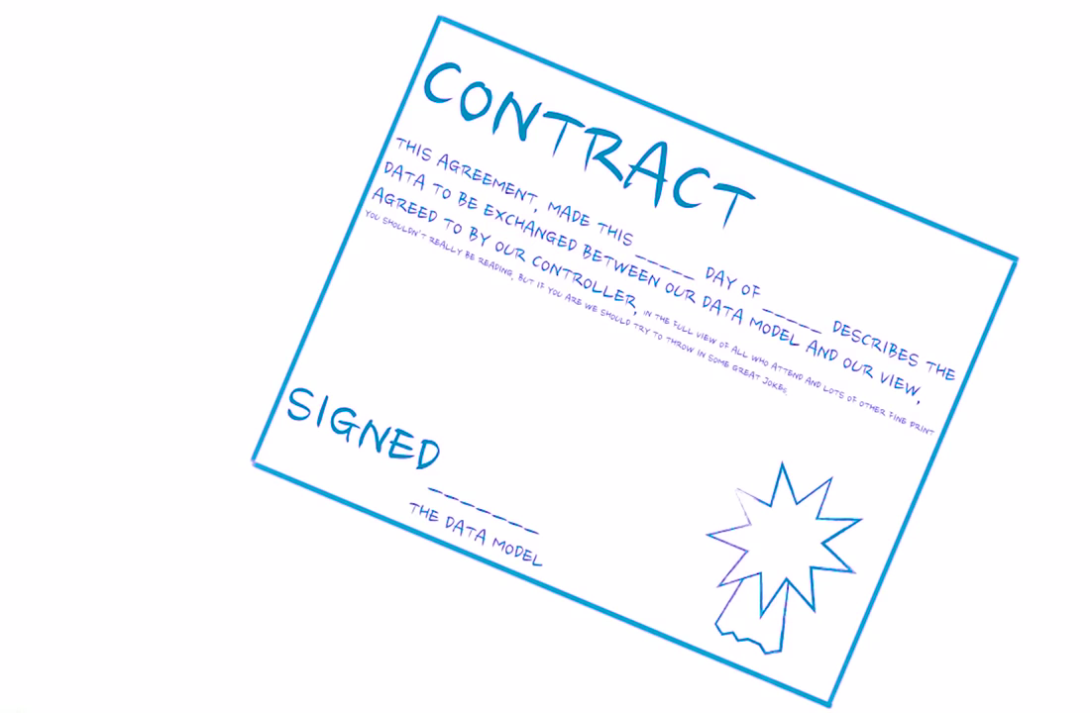
Data Contract

Slide 23
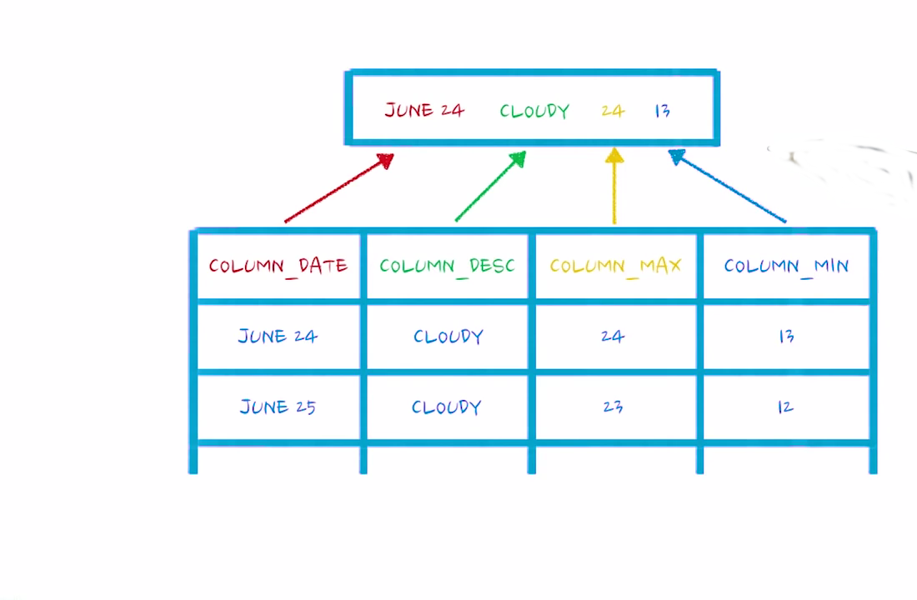
Data Contract UI vs Data Source

Slide 24
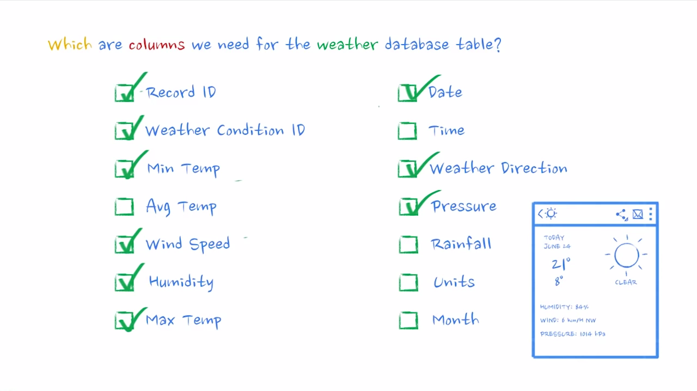
Weather Table Columns

Slide 25
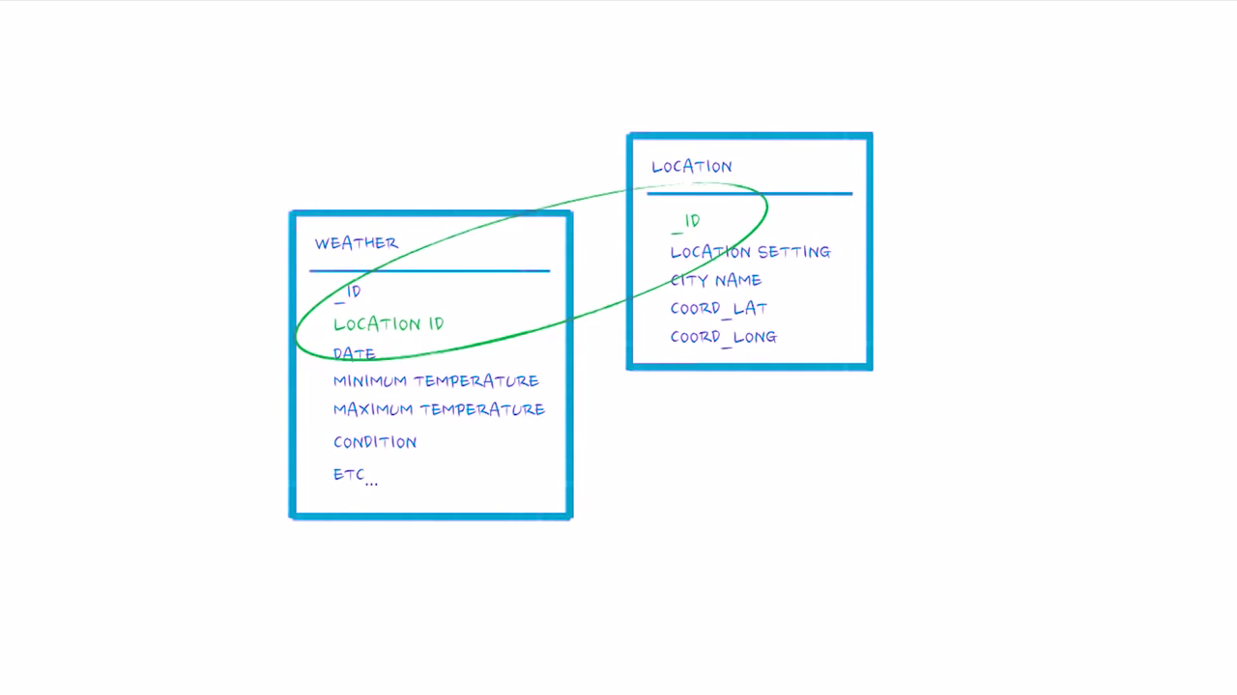
Weather and Location Tables

Slide 26
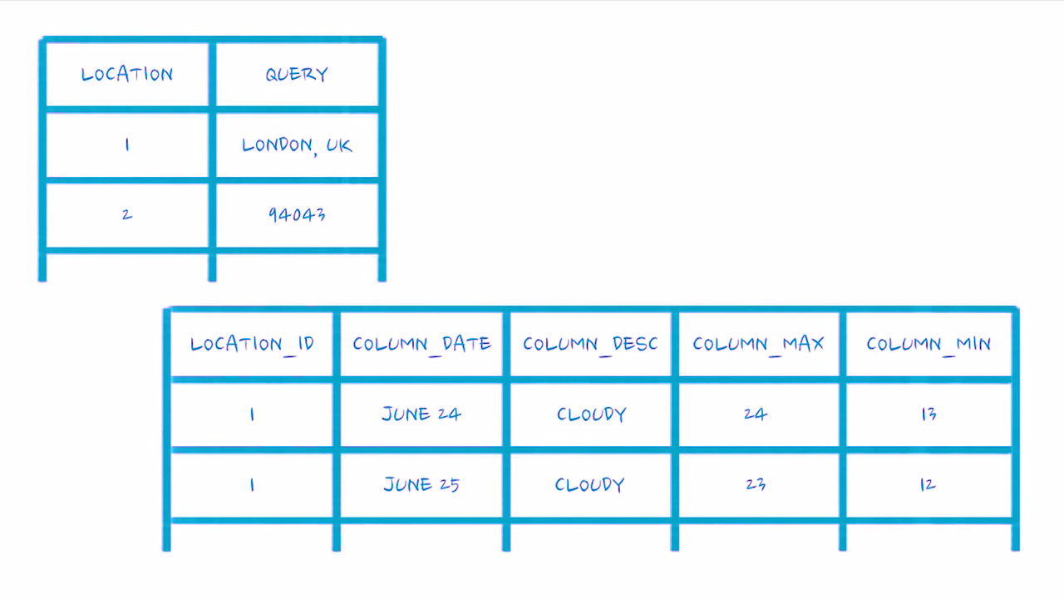
Weather and Location Tables

Slide 27
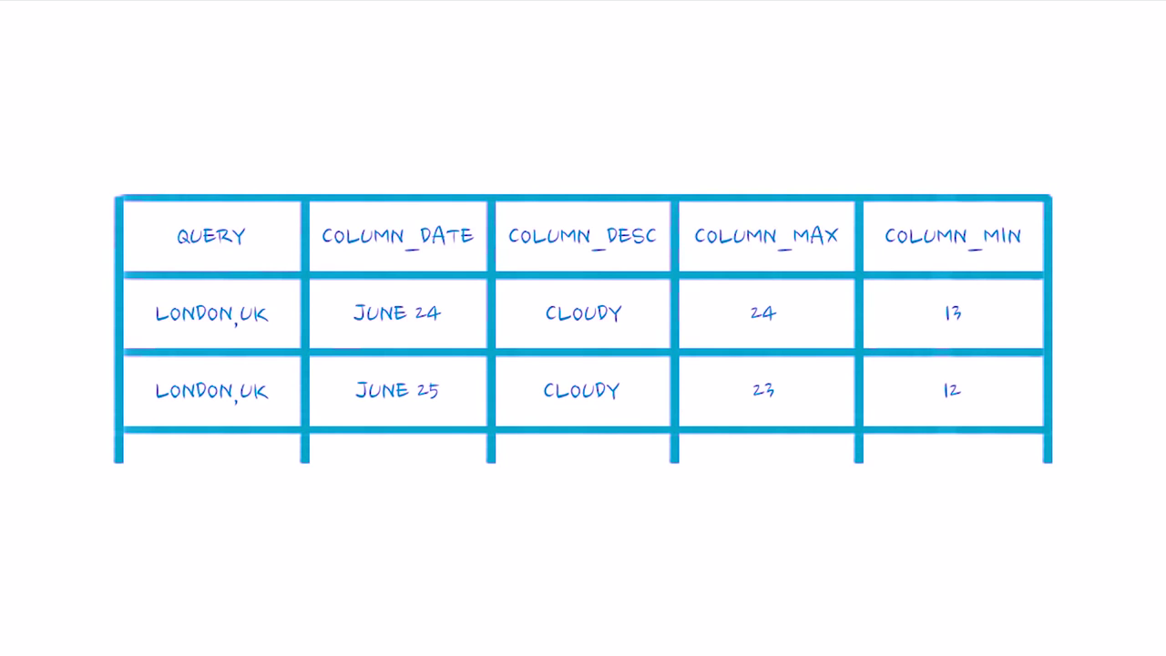
Weather and Location Tables Inner Joins

Slide 28
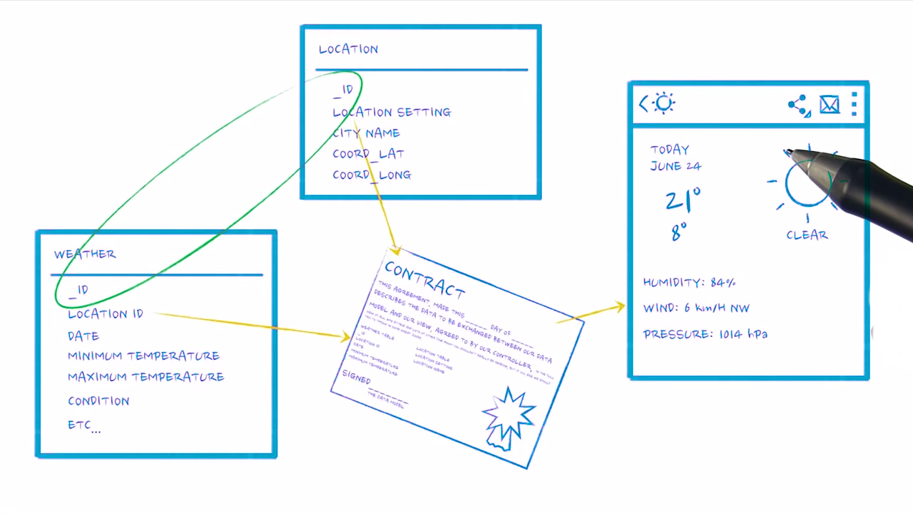
Weather Contract

Slide 29
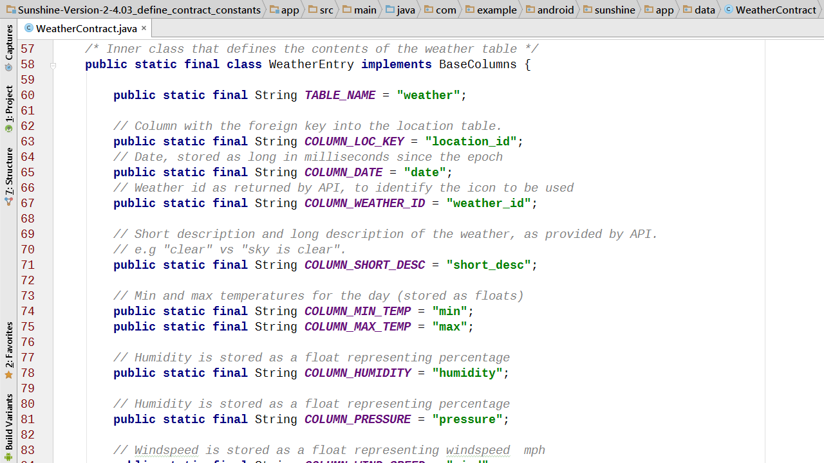

Slide 30
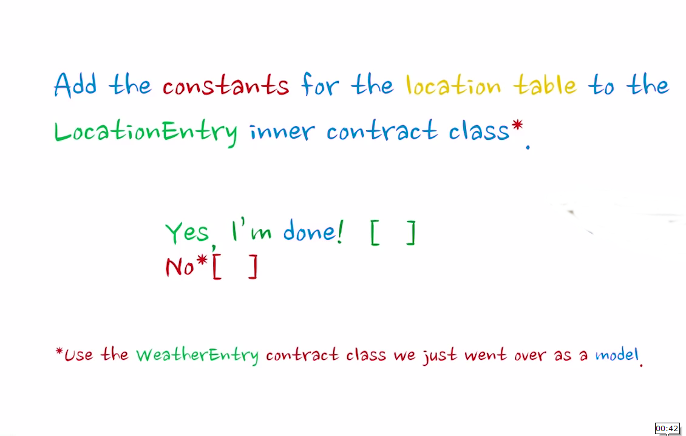
Define Constants in Contract

Slide 31
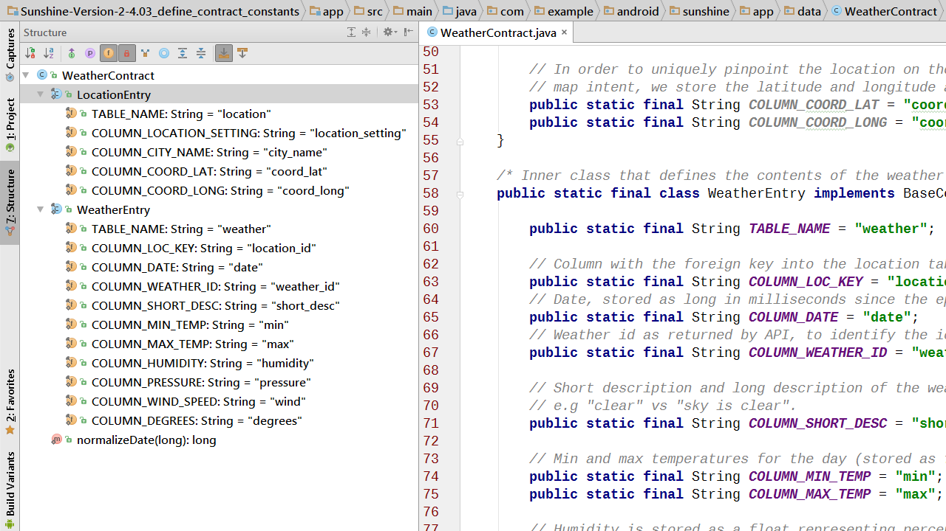

Slide 32
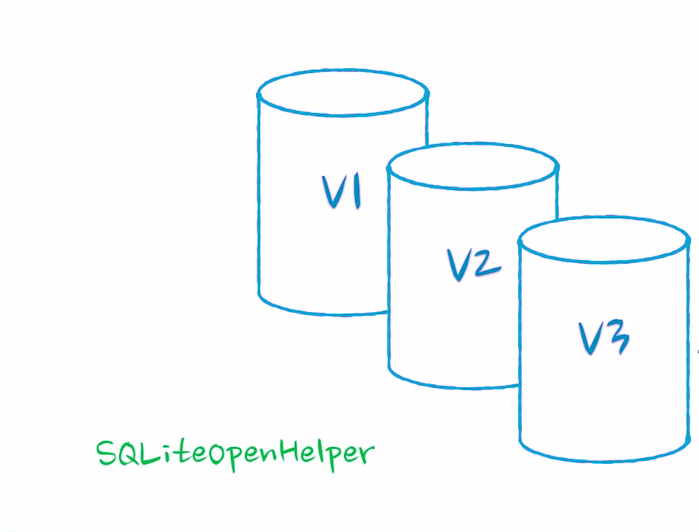
SQLiteOpenHelper

Slide 33
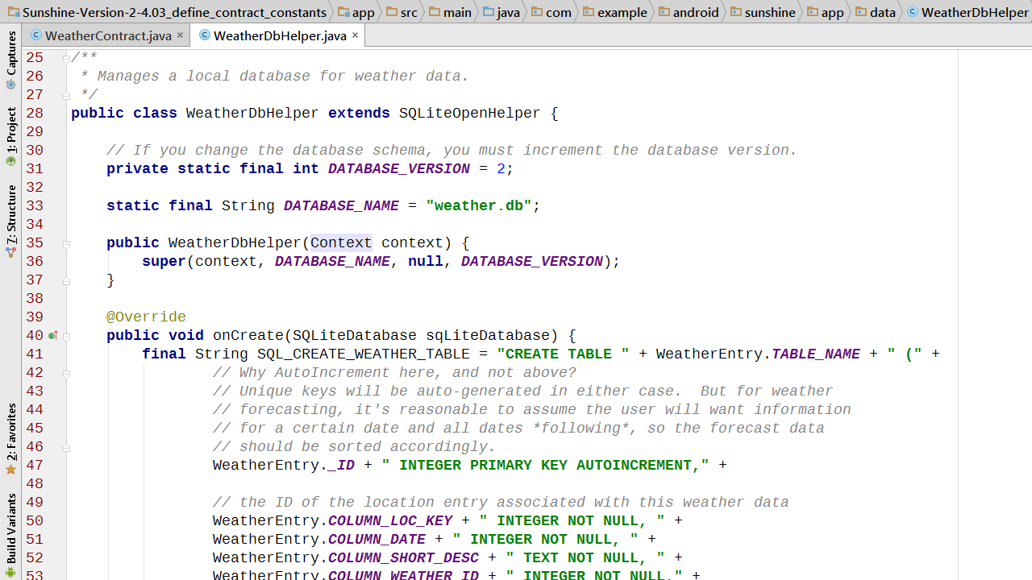
WeatherDbHelper

Slide 34
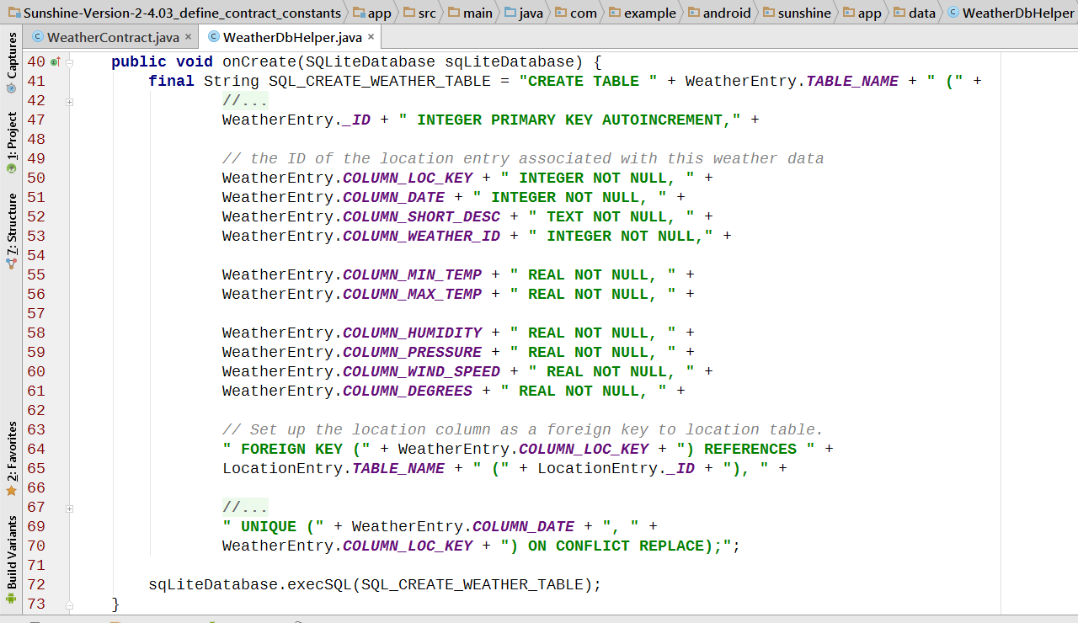

Slide 35
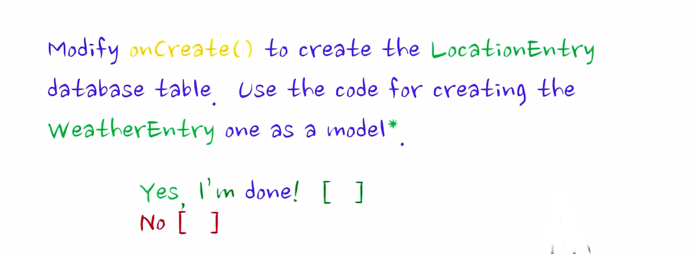
Location Table

Slide 36
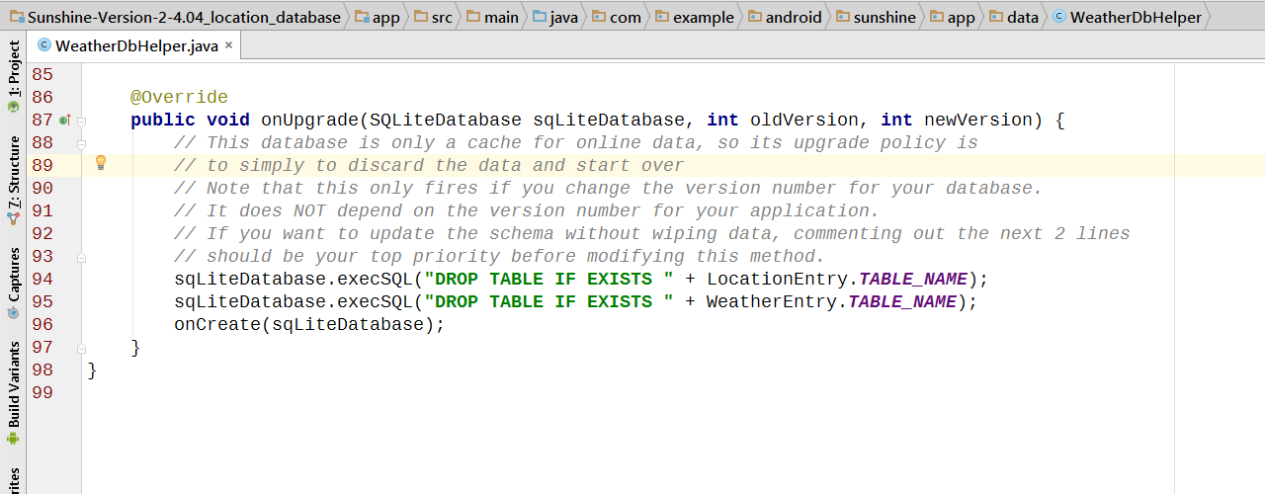
SQLiteOpenHelper onUpgrade()

Slide 37
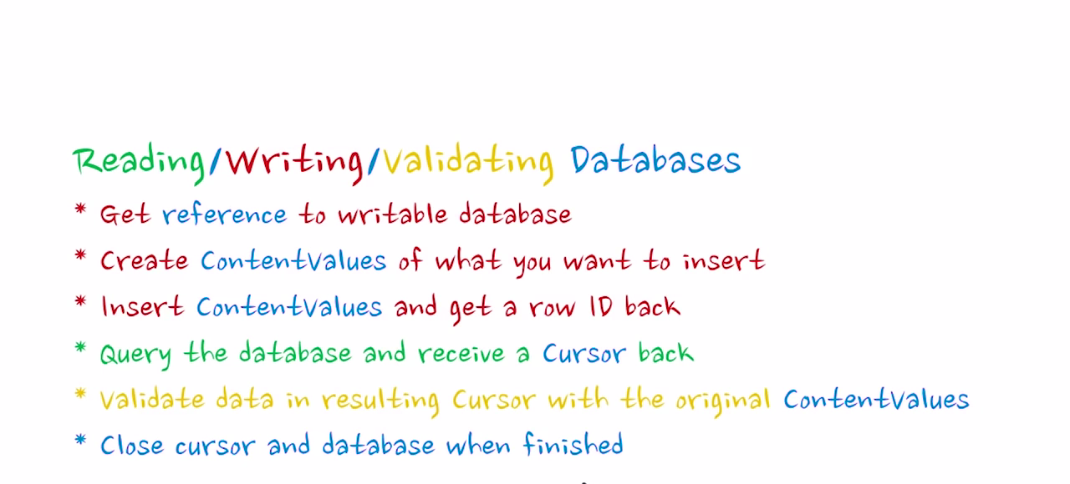

Slide 38
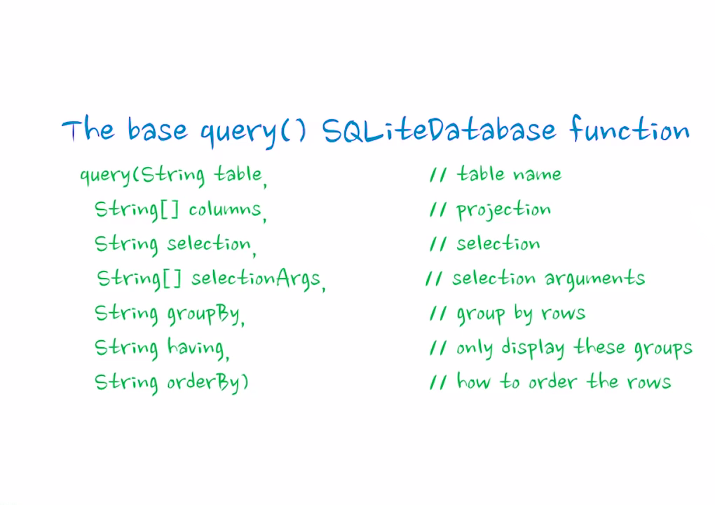

Slide 39
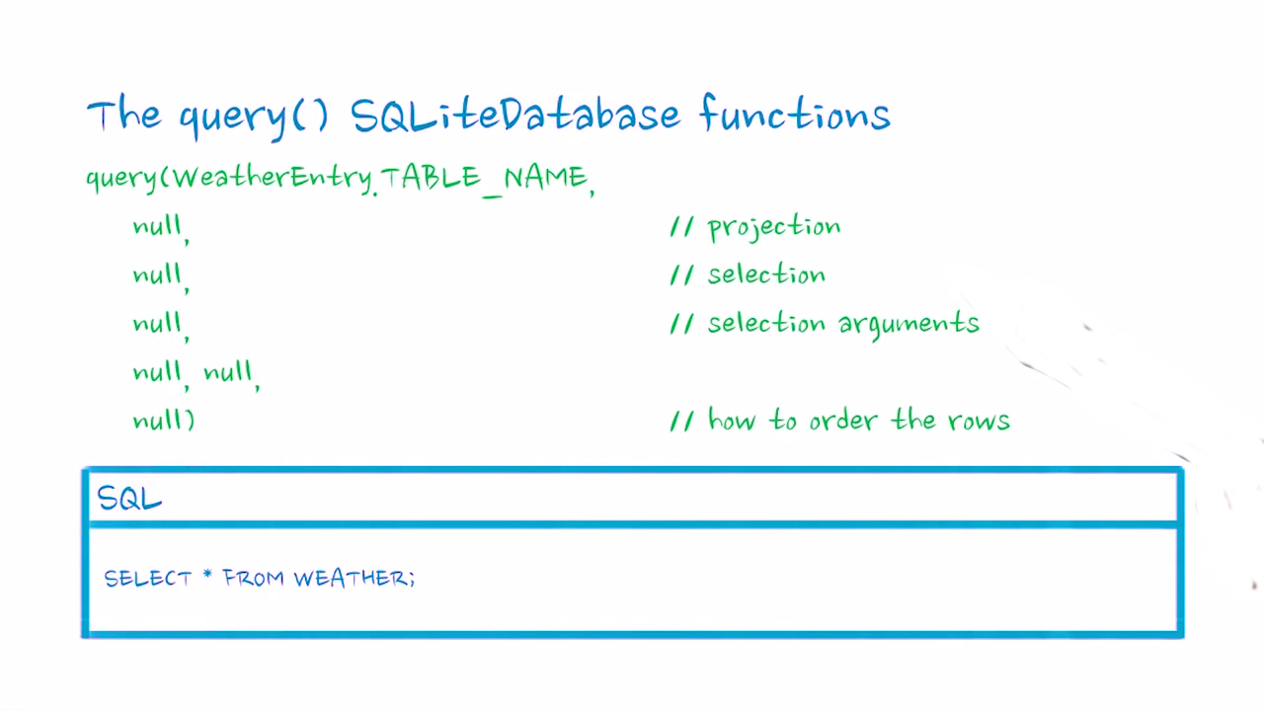

Slide 40
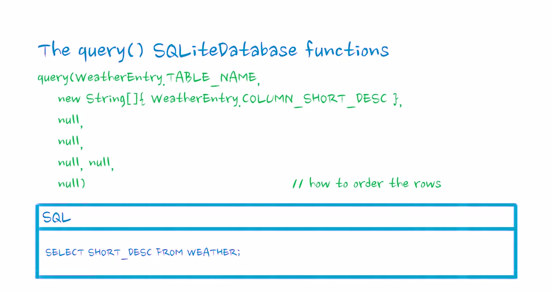

Slide 41
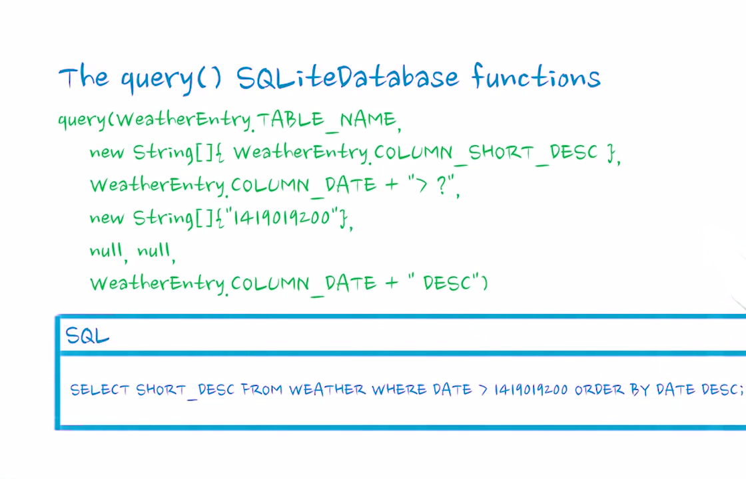

Slide 42
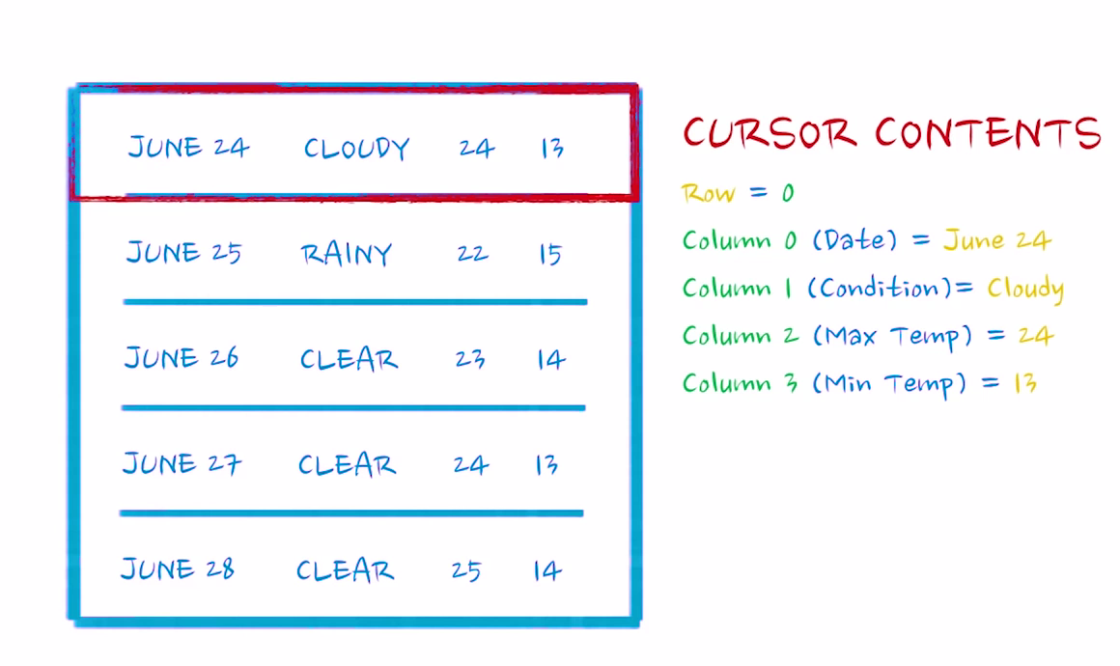

Slide 43
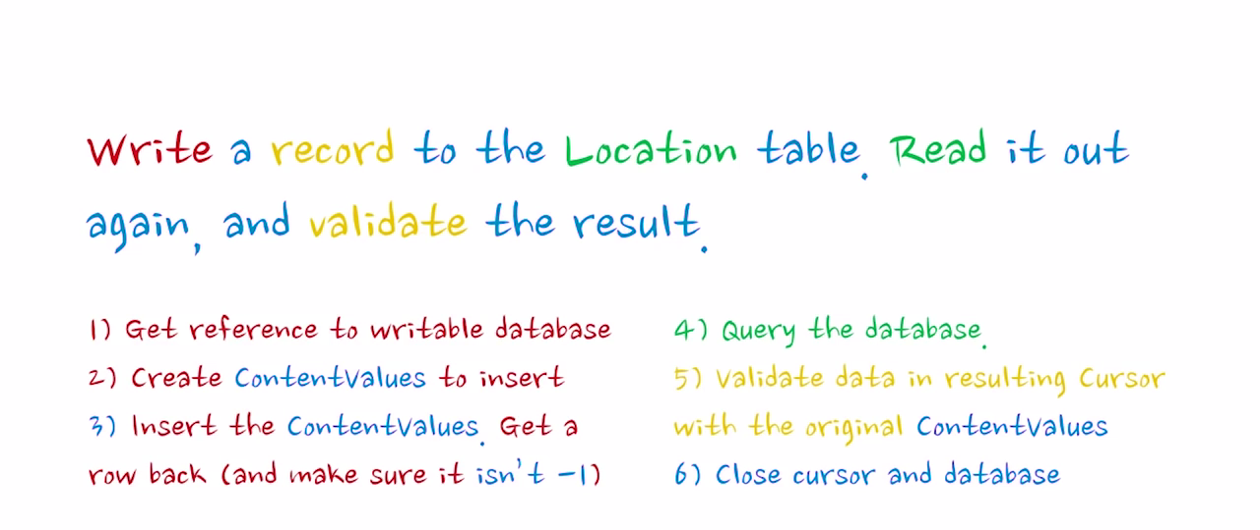
Test Read/Write from Location Table

Slide 44
Test Read/Write from Weather Table

